Slide 2
Do Now
What is figurative language?
used with a meaning that is different from the basic (literal) meaning and that expresses an idea in an interesting way by using language that usually describes something else.
Figurative language is a tool that an author employs to help the reader visualize what is happening in a story or poem.

Slide 3
Types of Figurative Language
Hyperbole – exaggerated statements or claims not meant to be taken literally
Simile – comparison of two unlike things, using “like” or “as”
Metaphor – comparison of two unlike things, using “to be” verb (is, are, was, were, am,
Personification – the attribution of human attributes to something non-human

Slide 4
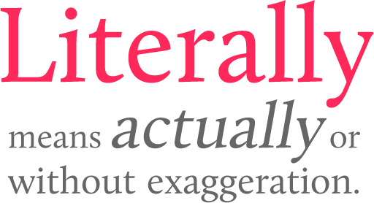
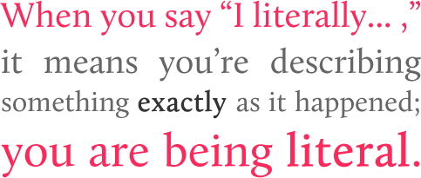
Figurative vs. Literal Language

Slide 5
Literal vs. Figurative Language
Scenario: You have been assigned a lot of homework
Literally, how much homework have you been assigned?
Figuratively, how does it feel to have a lot of homework?

Slide 6
Literal vs. Figurative Language
Literal: “I have homework in Chemistry, English, and Spanish tonight. It is going to take me at least 2 hours to finish it all. I take no pleasure in this fact.”
Figurative: “If my homework were an animal, it’d be the offspring of a grizzly bear and a rabid piranha that survived radioactive testing to mutate into soul-destroying beast intent on bashing my skull into a cerebellum smoothie, which it would then drink, before puking it up and wasting 20 hours of my stupid life.”

Slide 7
Writing 101
Essay Structure
We will write many different types of essays in this class, but the basic structure of the essays will remain the same:
Title
Intro Paragraph (Hook, Bridge, Thesis)
Body Paragraph (Topic Sentence, Evidence/Analysis/Elaboration)
Conclusion (Reiteration, Call to Action, Send Off)
Works Cited Page (if necessary

Slide 8
Writing 101
Parts of Speech
Noun – person, place, thing, idea
Verb – action word
Adjective – describes/modifies noun and pronouns
Adverb – describes/modifies verbs, adjectives, adverbs
Pronoun – used in place of noun or other pronoun
Conjunction – joins words (or groups of words) together
Preposition – shows relationship of nouns to other words in a sentence
Interjection – expresses emotion – no grammatical relationship to other words

Slide 9
Parts of Speech Quick Diagnostic
Identify the part of speech for the underlined word in each of the sentences below.
He walked around the corner
Can Zach help him with the science project?
Older people tire more easily.
The student intelligently answered the questions.
This classroom is excessively warm.
Hurray! Our team finally scored a point!
I want to hang out, but I have a ton of work to do.

Slide 10
Annotation Guidelines
What does it mean to annotate a text?
What’s the point of annotating?

Slide 11
Annotation Guidelines
As you thoughtfully read and focus on key passages of a text,
identify important or striking features,
notice patterns,
predict meanings, and
annotate, or “mark up,” the text to show your observations and thoughts.

Slide 12
Annotation Guidelines
In the margins, write brief comments. If the margins are narrow, you may want to use post-it notes. When writing comments, you might …
Observe what is being said or done
Define unfamiliar words
Identify a theme being developed
Paraphrase or summarize a difficult
phrase, sentence or passage
Describe the effect of an image, sound, or word
Identify a literary technique
Infer a character quality
Ask a thoughtful question or predict an outcome

