Slide 1
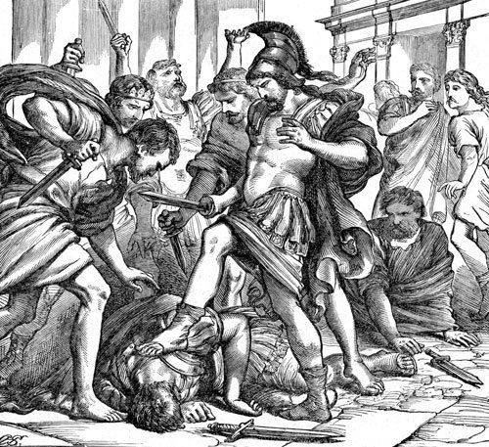
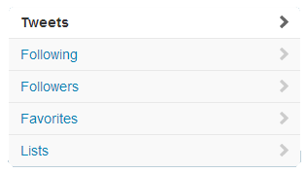
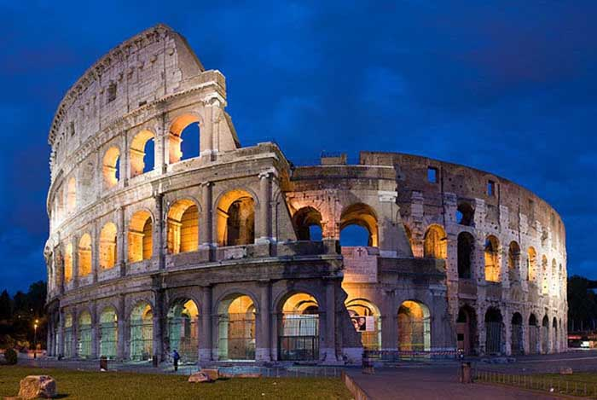
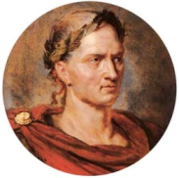
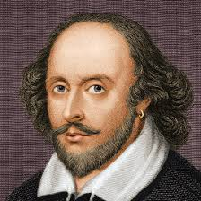
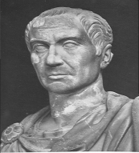
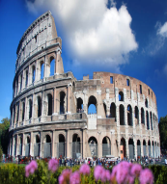
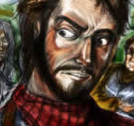
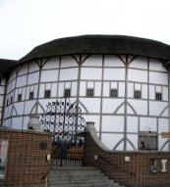
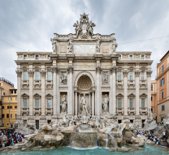
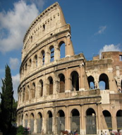
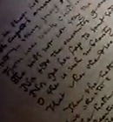
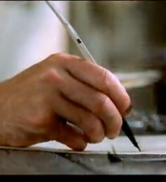
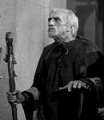
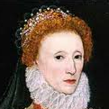
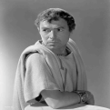
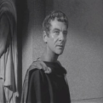
Julius Caesar
@CaesarSalad
Ruler of Rome
Rome – http://www.JuliusC.com
William Shakespeare
@CaesarSalad
14,234
5,321
3,445,234
Julius Caesar @CaesarSalad 9d
That moment when your best friends stab your back. Literally. #NotCool #Ouch #AnyoneGotABTypeBlood?
Julius Caesar @CaesarSalad 9d
@SoothSaya March 15. Nothin Dude. #Liar #GetReal
Expand
Soothsayer @SoothSaya 27d
@CaesarSalad March 15. You gonna get it. #WatchYo’self #Warned
Retweeted by Julius Caesar
Marcus Brutus @Brutal
Followed by Calpurny and others
Follow
Caius Cassius @Cassy
Followed by Portia and others
Follow
Julius Caesar @CaesarSalad 27d
Can’t accept dat crown #TheStruggle #Sigh
Julius Caesar @willyshakes 28d
@MarkAntony Only time I’d let someone slap my
wife #FestivalTime #WantThatBaby
#StabbinHurts

Slide 2
Julius Caesar
@CaesarSalad
Ruler of Rome
Rome – http://www.JuliusC.com
William Shakespeare
@CaesarSalad
14,229
5,319
3,443,200
Julius Caesar @CaesarSalad 9d
@Brutal @Cassy @Decius @Cinna No way in Hades is Publius coming back #NotHappening #Banished4Life
Julius Caesar @CaesarSalad 9d
@Brutal On my way to the Senate House #RunningLate
Expand
Julius Caesar @CaesarSalad 9d
@Decius I was beginning to think that my bae was right, thanks dude. #Ashamed #NotSoBad
Marcus Brutus @Brutal
Followed by Calpurny and others
Follow
Caius Cassius @Cassy
Followed by Portia and others
Follow
Julius Caesar @CaesarSalad 9d
@Calpurny I AM THE DANGER #ChillBabe #IGotThis
Julius Caesar @willyshakes 9d
The bae kept screaming all night saying she had a nightmare. #GotMeUpAllNight #AllNighter #Tired
#StabbinHurts

